Slide 1
MATLAB for image processing Session 2: Matrices and image processing

Slide 2
Course structure
Session 1
Introduction to MATLAB
Data types
Conditional statements and loops
Session 3
Advanced data structures
Advanced image reading (Bioformats)
Object-oriented programming
Session 2
Matrix operations
Image processing
Session 4
Figures and plotting
Designing a user interface

Slide 3

Under construction!
Comments/requests?
Let me know!
stephen.cross@bristol.ac.uk

Slide 4
Matrices
Notes:
Convert this into 2 spider diagrams if there’s time

Slide 5
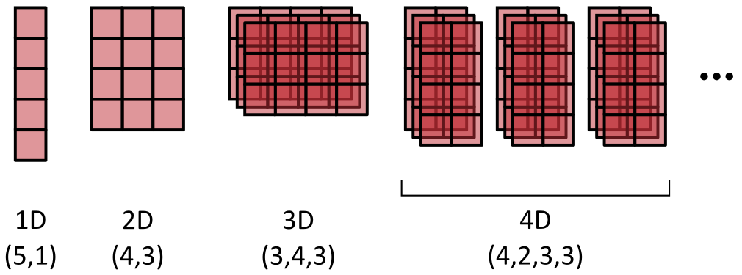
Introduction to matrices
So far we’ve only looked at variables holding a single value
Matrices hold multiple numeric values in an n-dimensional grid
MATLAB is specifically optimised for calculations on these
Have a minimum of 2 dimensions (XY)
XY dimensions always specified first in the order (row, column)

Slide 6
Introduction to matrices
Images are an example of a 2D matrix
Pixels stored on regular grid
Each element (pixel) accessed by its coordinates
Often referred to as “indexing”
Moving beyond 2D
Higher dimensionalities used for colour, depth and/or time
ZOOM IN ON IMAGE, SHOWING PIXELS APPEAR AT HIGH MAG
WHEN AT MAX MAG SHOW GRID AND COORDINATES SUPERIMPOSE OVER IMAGE

Slide 7
Accessing matrix values
Notes:
Convert this into 2 spider diagrams if there’s time

Slide 8
Indexing matrices
Elements of a matrix indexed using square bracket notation
Square brackets applied to variable name
First index specifies row, second specifies column
Index numbering starts at 1
Example, a random number array
Create a 2D matrix: rand_array = rand(4,3);
Top-left value: tl_val = rand_array[1,1];
Bottom-left val: bl_val = rand_array[4,1];
Top-right val: tr_val = rand_array[1,3];

Slide 9
Indexing matrices
Elements of a matrix indexed using square bracket notation
Square brackets applied to variable name
First index specifies row, second specifies column
Index numbering starts at 1
Example, a random number array
Create a 2D matrix: rand_array = rand(4,3);
Top-left value: tl_val = rand_array[1,1];
Bottom-left val: bl_val = rand_array[4,1];
Top-right val: tr_val = rand_array[1,3];
0.9 | 0.3 | 0.1
0.2 | 0.1 | 0.5
0.4 | 0.7 | 0.2
0.7 | 0.3 | 0.5

Slide 10
Indexing matrices
Elements of a matrix indexed using square bracket notation
Square brackets applied to variable name
First index specifies row, second specifies column
Index numbering starts at 1
Example, a random number array
Create a 2D matrix: rand_array = rand(4,3);
Top-left value: tl_val = rand_array[1,1];
Bottom-left val: bl_val = rand_array[4,1];
Top-right val: tr_val = rand_array[1,3];
0.9 | 0.3 | 0.1
0.2 | 0.1 | 0.5
0.4 | 0.7 | 0.2
0.7 | 0.3 | 0.5

Slide 11
Indexing matrices
Elements of a matrix indexed using square bracket notation
Square brackets applied to variable name
First index specifies row, second specifies column
Index numbering starts at 1
Example, a random number array
Create a 2D matrix: rand_array = rand(4,3);
Top-left value: tl_val = rand_array[1,1];
Bottom-left val: bl_val = rand_array[4,1];
Top-right val: tr_val = rand_array[1,3];
0.9 | 0.3 | 0.1
0.2 | 0.1 | 0.5
0.4 | 0.7 | 0.2
0.7 | 0.3 | 0.5

Slide 12
Indexing matrices
Elements of a matrix indexed using square bracket notation
Square brackets applied to variable name
First index specifies row, second specifies column
Index numbering starts at 1
Example, a random number array
Create a 2D matrix: rand_array = rand(4,3);
Top-left value: tl_val = rand_array[1,1];
Bottom-left val: bl_val = rand_array[4,1];
Top-right val: tr_val = rand_array[1,3];
0.9 | 0.3 | 0.1
0.2 | 0.1 | 0.5
0.4 | 0.7 | 0.2
0.7 | 0.3 | 0.5

Slide 13
Indexing matrices
Exercise: Indexing a single value in a matrix
Create a random number matrix with 5 rows and 4 columns
- Skip the semicolon at the end of the line, so we can see the matrix
Access the bottom right element and store as a new variable
Does the new variable have the correct value?

Slide 14
Indexing matrices
We can access more than on value at a time
Use the colon operator to specify a range
Colon on its own indicates the full range
Specify a subset of the range with start:end form
Specify an interval range with start:interval:end form
Back to our random number array
All first row: row_1 = rand_array[1,:];
All second column: col_2 = rand_array[:,2];
Subset of third col.: col_3 = rand_array[1,3];
2D region: subset_2D = rand_array[2:3,1:3];
0.9 | 0.3 | 0.1
0.2 | 0.1 | 0.5
0.4 | 0.7 | 0.2
0.7 | 0.3 | 0.5

Slide 15
Creating matrices
Notes:
Convert this into 2 spider diagrams if there’s time

Slide 16
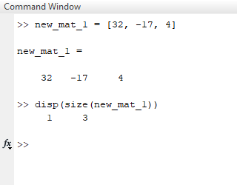
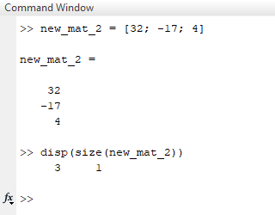
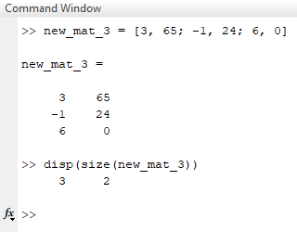
Creating 2D matrix from known values
Surround values with square brackets
Comma-separate items on the same row
Semicolon-separate rows
A single row
A single column
A true 2D matrix

Slide 17
Combining matrices
Matrices can be joined along existing or new axes
Used to create higher dimensionalities than 2D
Using concatenation function
Create separate matrices, then join using cat function
First argument of cat specifies axis to concatenate along
By indexing
Create separate matrices, then merge one into the other
Not as simple to extend existing dimensions (cat is better)
We’ll look into indexing in more detail later on

Slide 18
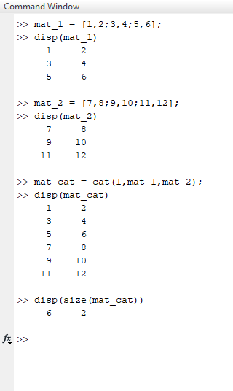
Combining matrices
Matrices can be joined along existing or new axes
Used to create higher dimensionalities than 2D
Using concatenation function
Create separate matrices, then join using cat function
First argument of cat specifies axis to concatenate along
By indexing
Create separate matrices, then merge one into the other
Not as simple to extend existing dimensions (cat is better)
We’ll look into indexing in more detail later on

Slide 19
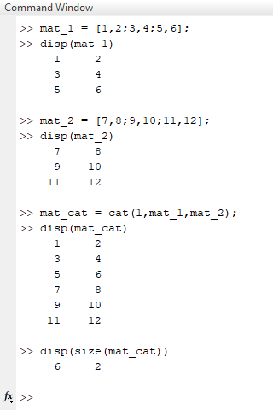
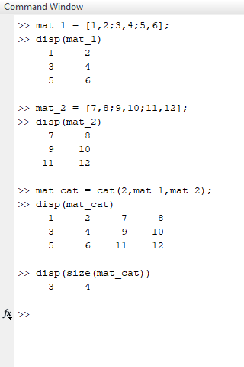
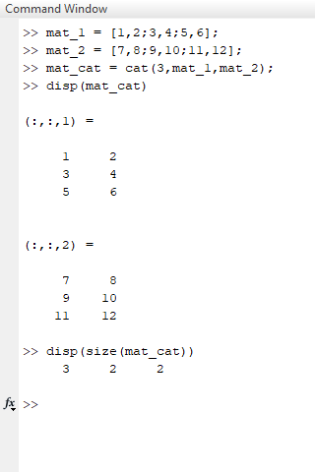
Combining matrices
Joining vertically
Joining horizontally
Joining along new axis

Slide 20
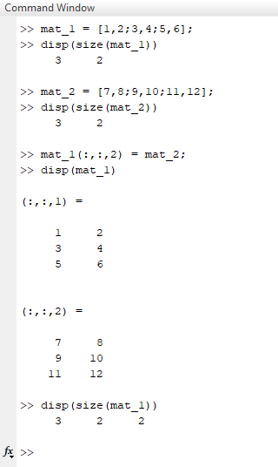
Combining matrices
Matrices can be joined along existing or new axes
Used to create higher dimensionalities than 2D
Using concatenation function
Create separate matrices, then join using cat function
First argument of cat specifies axis to concatenate along
By indexing
Create separate matrices, then merge one into the other
Not as simple to extend existing dimensions (cat is better)

Slide 21
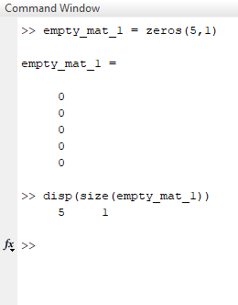
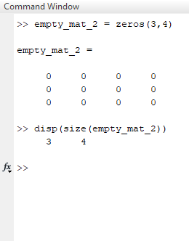
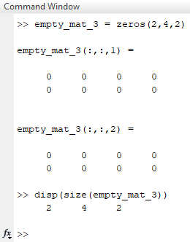
Creating an empty matrix
Initialising the empty matrix using zeros function
This preallocates the necessary memory
1D (ish)
2D
3D

Slide 22
The need for initialisation
Why can’t we create a small matrix and resize as necessary?
Matrices can be re-sized (e.g. via cat), but this is SLOW
Resize operations require the matrix to be moved in the PC’s memory
We can see this wasted time using a couple of tools
TicToc
Tells us the time between tic and toc commands
Profiler
A graphical tool to evaluate code performance in greater detail
Reports number of calls per line
Reports time taken per line

Slide 23
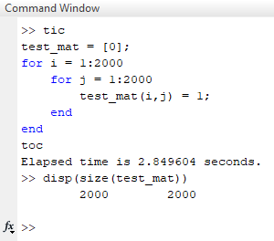
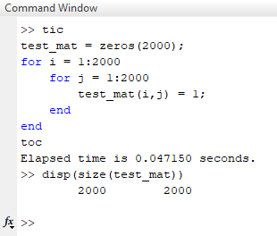
Tic Toc
Tells us the time between tic and toc commands
Start timing using tic command
Get the time elapsed since tic using toc command
Resizing array
Initialising with zeros

Slide 24
Tic Toc
1000px x 1000px
2000px x 2000px
3000px x 3000px

Slide 25
Profiler
Evaluates the time taken by each line of code
Only works for scripts and functions
Doesn’t work on code in the command window
Using the profiler
Start profiler using profile on
Stop profiler using profile off
View profile results using profiler viewer
Clear previous results with profile clear

Slide 26
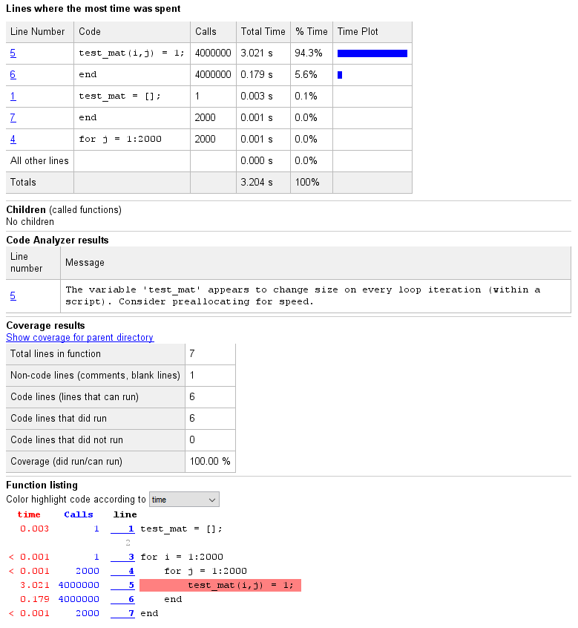
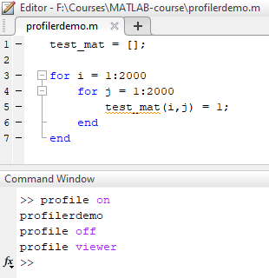
Profiler

Slide 27
Matrix operations
Notes:
Convert this into 2 spider diagrams if there’s time

Slide 28
Introduction to matrices
Matrix operations
Start by adding a single value to a matrix
Add two matrices together
Talk about the element-wise dot (e.g. .*)

Slide 29
Image processing
Notes:
Convert this into 2 spider diagrams if there’s time

Slide 30
Image loading
Using standard libraries
imread
Oh look, they’re matrices
Multidimensionality

Slide 31
Visualising images
image
imagesc
imshow

Slide 32
Image processing
Filters
Median
Gaussian
Thresholding
Otsu method

Slide 33
Saving images
imwrite

